Slide 1
HR Analytics
Udit Singh Rawat
Bhagyahsree
CHRISTY V THUNDIYIL
Krushana Pandharinath Ahire
R.Swathi
Satyam Pandey
ABHISHEK U B

Slide 2





Tools Used:

Slide 3
AGENDA
Introduction
Project Overview
KPI’s
Dashboard Design
Conclusion

Slide 4
AGENDA
Introduction
Project Overview
KPI Analysis
Dashboard Design
Conclusion

Slide 5
Project Overview
The aim of this project is to analyze employee retention and attrition rates with the organization and provide insights to the HR team for developing effective retention strategies. Through data analysis and visualizations, we will identify factors that contribute to
Evaluate the effectiveness of existing retention strategies.
To verify the satisfaction level of employee in the organization.
Provide recommendations to improve employee retention.
Employee turnover and attrition.

Slide 6
Introduction
HR analytics involves the collection and analysis of HR-related data, including employee data, performance metrics, and other relevant data points. By using advanced analytical tools and techniques, HR analytics provides valuable insights into HR processes and trends, enabling organizations to make more informed decisions about their employees and improve overall performance.

Slide 7
KPI’s
Average Attrition rate for all Departments
Average Hourly rate of Male Research Scientist
Attrition rate Vs Monthly income stats
Average working years for each Department
Job Role Vs Work life balance
Attrition rate Vs Year since last promotion relation

Slide 8
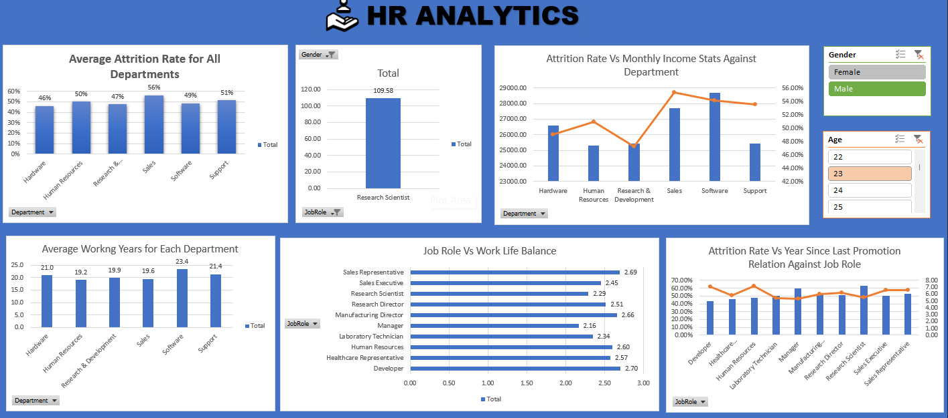
Excel Dashboard

Slide 9
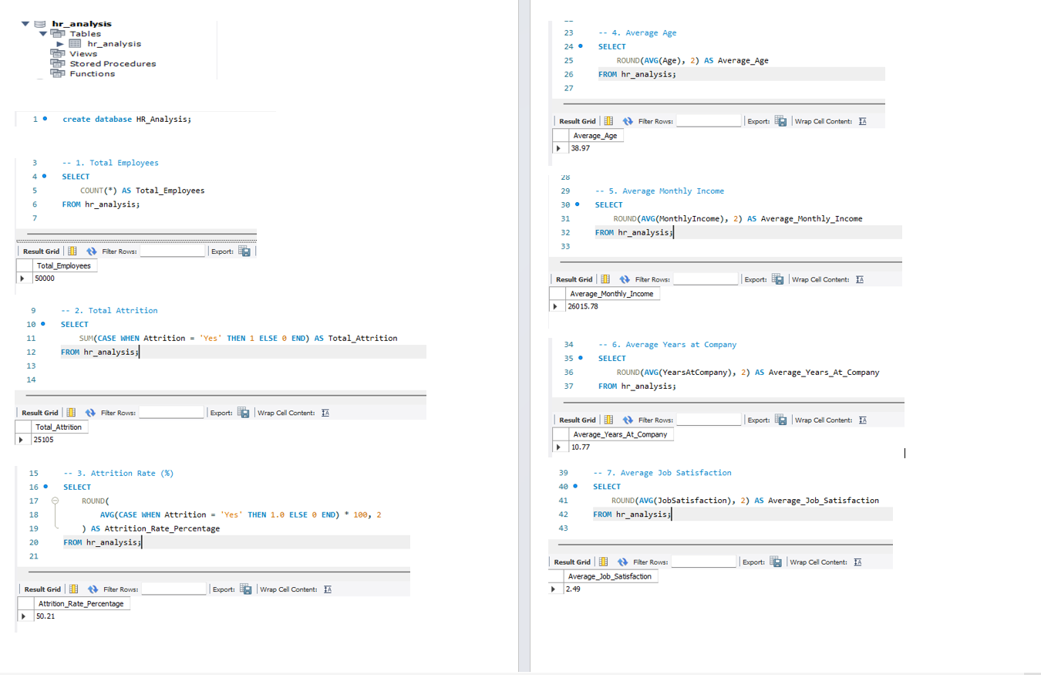
My SQL Queries

Slide 10
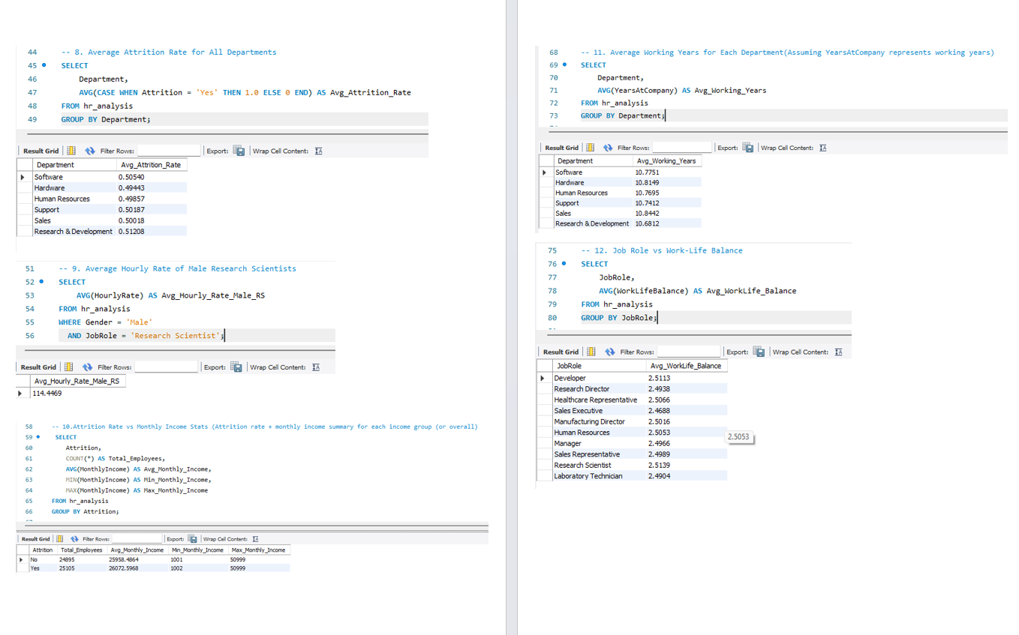

Slide 11
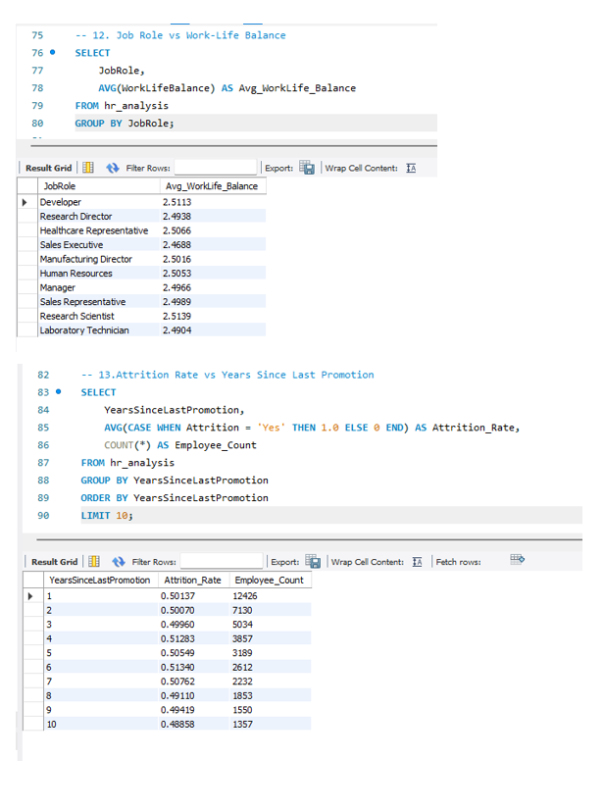

Slide 12
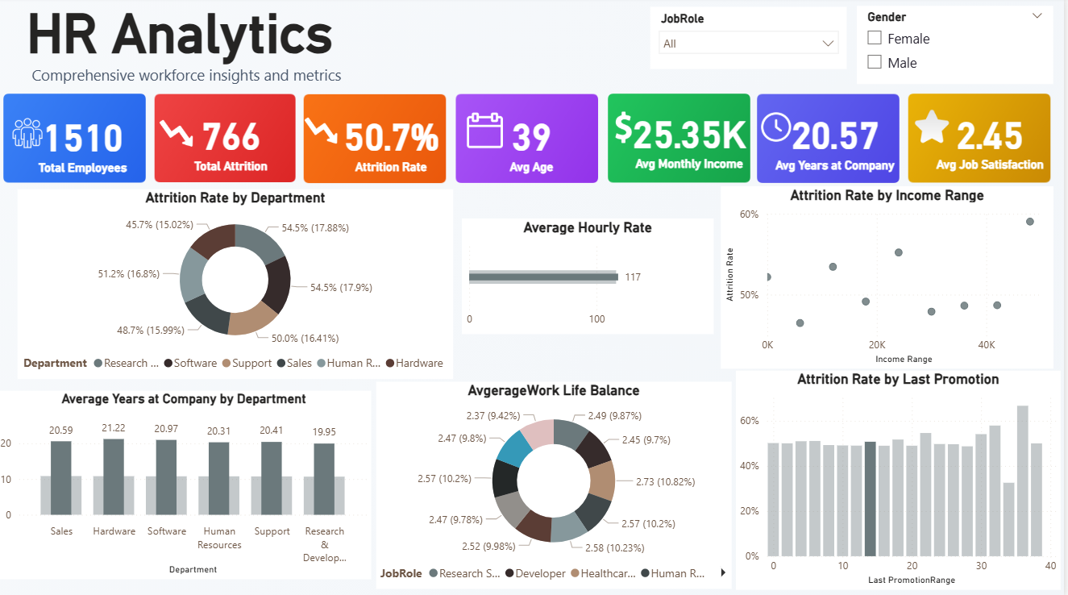
Power BI Dashboard

Slide 13
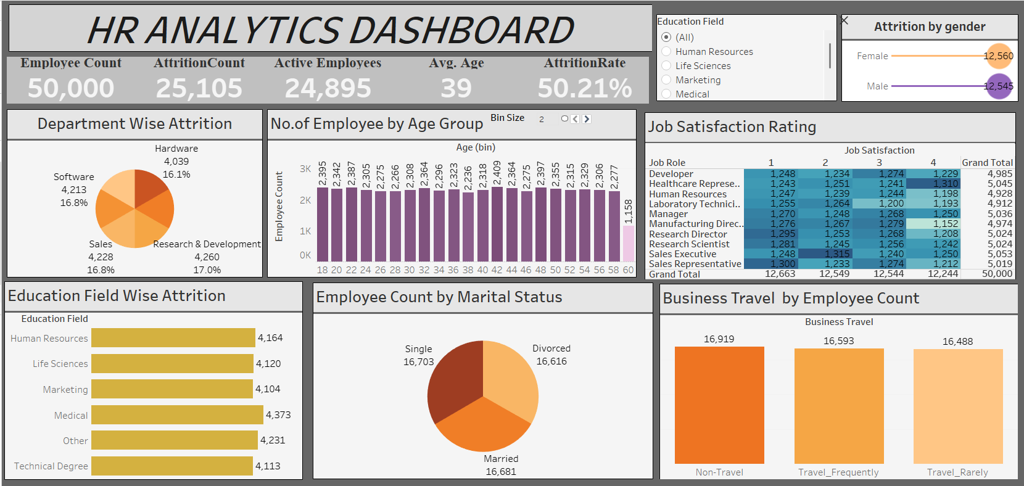
Tableau Dashboard

Slide 14
Conclusion
Strengthen Engagement Programs: Drive employee commitment through structured initiatives such as continuous feedback mechanisms, formal recognition platforms, performance-based rewards, and well-defined career advancement pathways.
Optimize Workload Management: Safeguard employee well-being by proactively monitoring task distribution, ensuring workloads remain balanced, and implementing adjustments to prevent fatigue and burnout.
Cultivate a Supportive Workplace Culture: Build an environment rooted in respect, inclusivity, and collaboration. Encourage transparent communication channels and foster teamwork to create a sense of belonging and shared purpose.
Ensure Equitable Compensation: Maintain fairness and competitiveness in pay structures by regularly reviewing compensation policies. Align rewards with performance outcomes and explore intrinsic motivators that inspire employees to remain engaged and committed.

Slide 15
Thank you !

